Slide 1
INTRODUCTION TO BIG DATA FRAMEWORKS
Module 2A - Hadoop

Slide 2
OVERVIEW OF THE CHAPTER
What is Hadoop?
Core Hadoop Components
Hadoop Ecosystem
Overview of : Apache Spark, Pig, Hive, Hbase, Sqoop

Slide 3
THE EVOLUTION OF DATA
In the past, the most difficult problem for businesses was how to store all the data.
The challenge now is no longer to store large amounts of information, but to understand and analyze this data.
By harnessing this data through sophisticated analytics, and by presenting the key metrics in an efficient, easily discernable fashion, we are afforded unprecedented understanding and insight into our data.
‹#›

Slide 4
THE EVOLUTION OF DATA
Unlocking the true value of this massive amount of information will require new systems for centralizing, aggregating, analyzing, and visualizing these enormous data sets.
In particular analyzing and understanding petabytes of structured and unstructured data poses the following unique challenges:
Scalability
Robustness
Diversity
Analytics
Visualization of the Data
‹#›

Slide 5
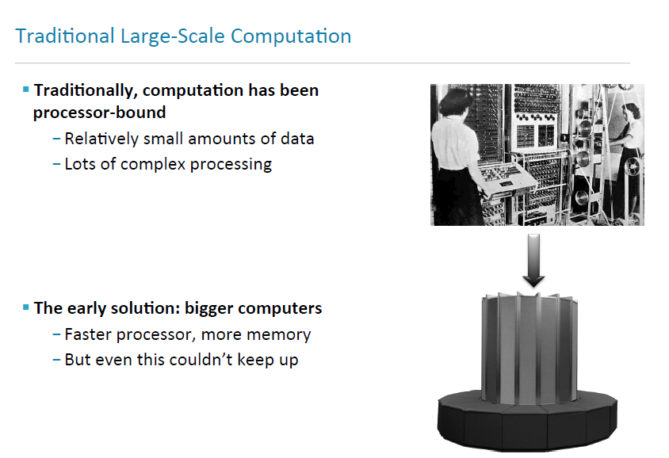

Slide 6
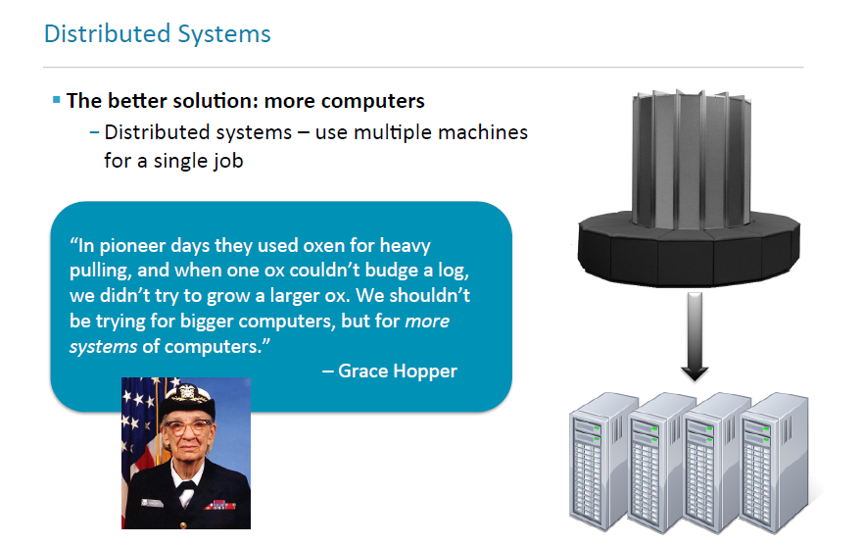

Slide 7
DISTRIBUTED SYSTEMS - PROBLEMS
Programming for traditional distributed systems is complex
Data exchange requires synchronization Finite bandwidth is available
Temporal dependencies are complicated
It is difficult to deal with partial failures of the system
Typically, data for a distributed system is stored on a SAN
At compute time, data is copied to the compute nodes
Fine for relatively limited amounts of data

Slide 8
PAST BIG DATA SOLUTIONS
Past Database Partitioning Options
Master / Slave
Cluster Computing
Table Partitioning
The drawback to the above-mentioned approaches is the reliance on shared facilities and resources (CPU, Disk, and Processors).
Each solution suffers from scalability limitations, and other drawbacks such as complex administration, lack of high availability and support for critical business requirements.
‹#›
Notes:
.

Slide 9
PAST BIG DATA SOLUTIONS
Data Shard’ing
Is a “shared nothing” partitioning scheme for large databases across a number of servers increasing scalability of performance of traditional relational database systems.
Essentially, you are breaking your database down into smaller chunks called “shards” and spreading them across a number of distributed servers.
The advantages of Sharding is as follows:
Easier to manage
Faster
Reduce Costs
‹#›

Slide 10
PAST BIG DATA SOLUTIONS
Data Shard’ing Shortcomings:
Reliability
Distributed Queries
Writing Sharding Code is difficult
No automated way to to perform load balancing
Shards are not synchronously replicated
‹#›

Slide 11
PAST BIG DATA SOLUTIONS
SANS
SANS are essentially dedicated, high performance storage networks that transfer data between servers and storage devices, separate from the Local Area Network (usually through fiber channels).
ADVANTAGES
Ability to move large blocks of data
High level of performance and availability
Dynamically balances loads across the network.
DISADVANTAGES
Complex to manage a wide scope of devices
Lack of Standardization
SANs are very expensive
‹#›

Slide 12
TRADITIONAL STORAGE SOLUTIONS
Off system/online storage/ secondary memory
File system abstraction/ Databases
Offline/ tertiary memory/ DFS
RAID: Redundant Array of Inexpensive Disks
NAS: Network Accessible Storage
SAN: Storage area networks

Slide 13
DESIRED CHARACTERISTICS
Partial failure support
Data recoverability
Component recovery
Consistency
Scalability

Slide 14
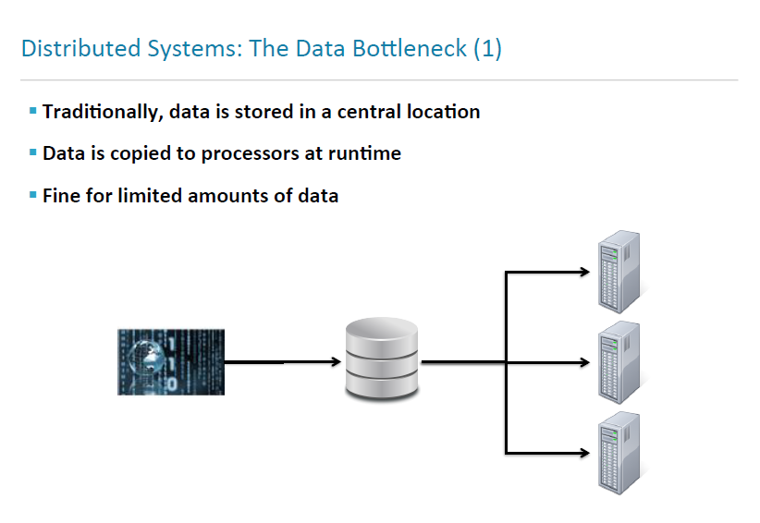

Slide 15
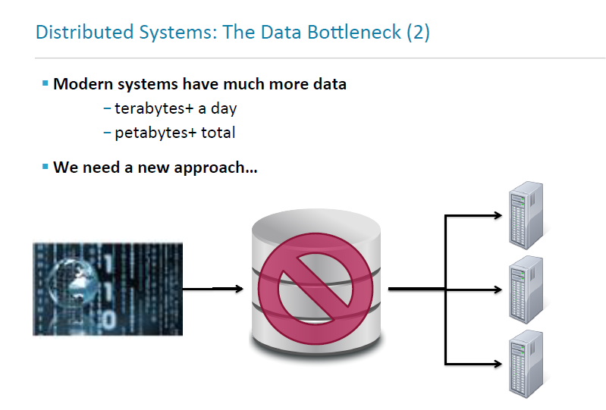

Slide 16
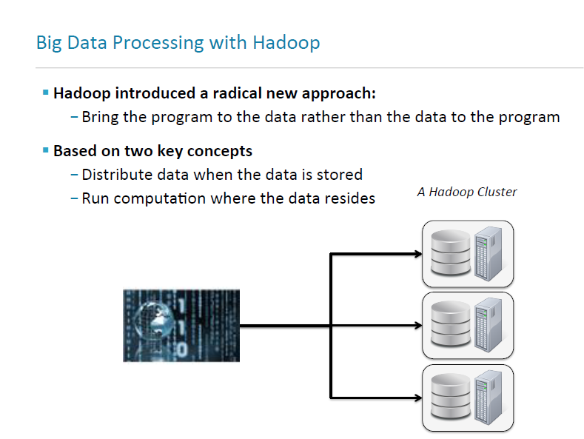

Slide 17
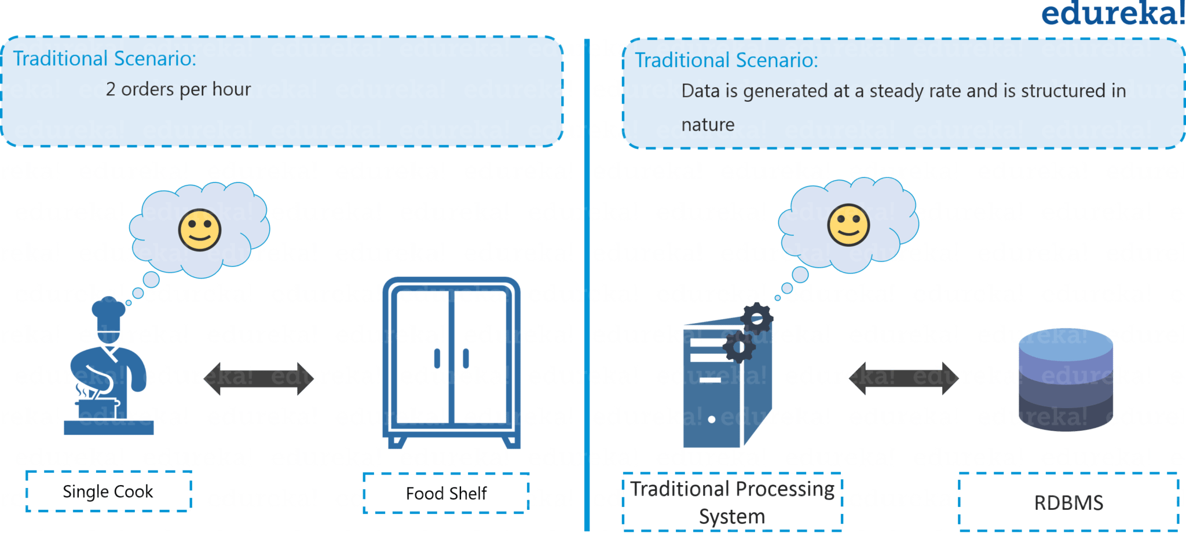
A MOTIVATING CASE STUDY- FOOD JOINT EXPANSION

Slide 18
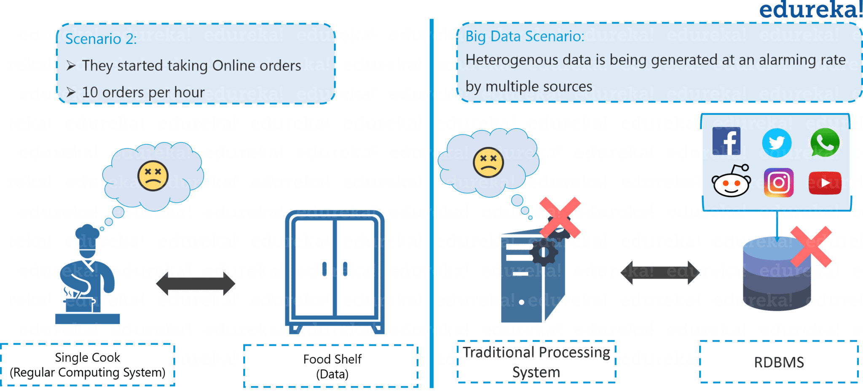

Slide 19
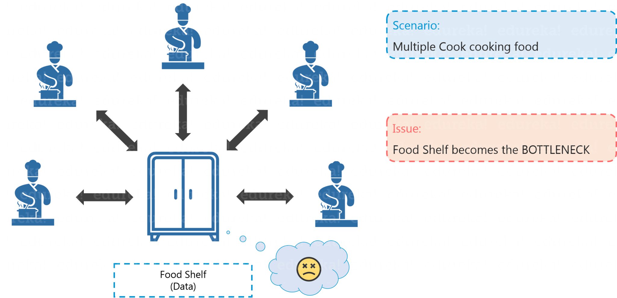
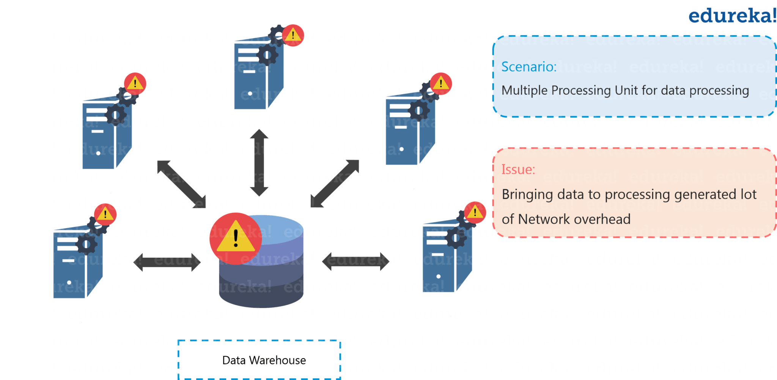

Slide 20
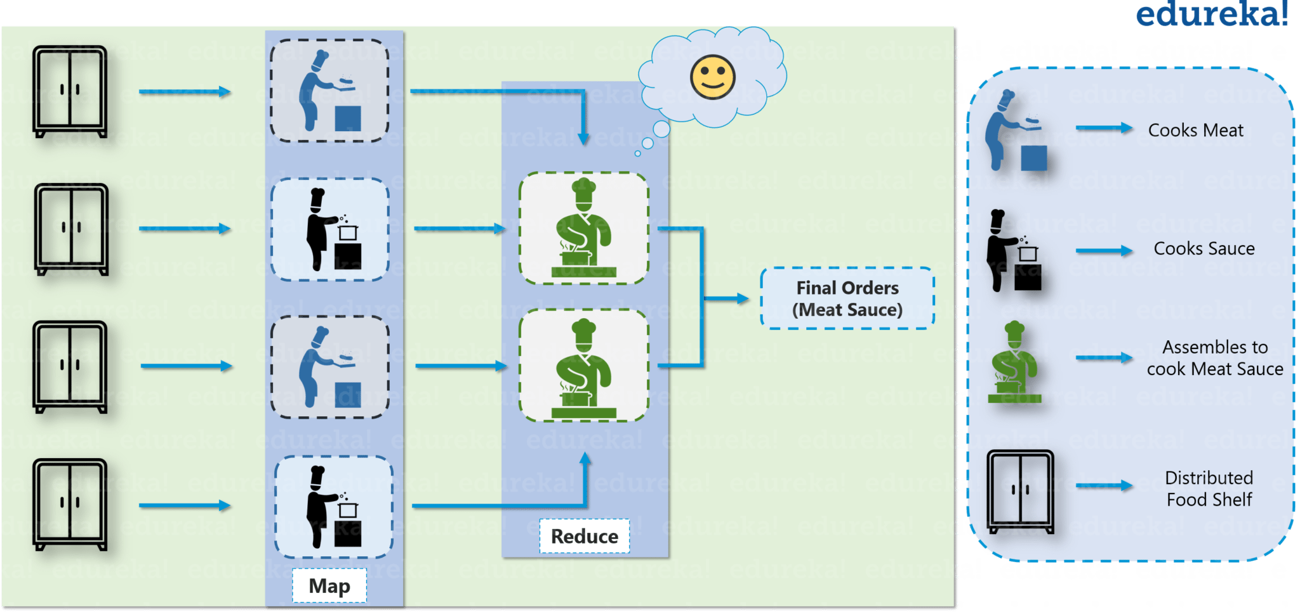

Slide 21
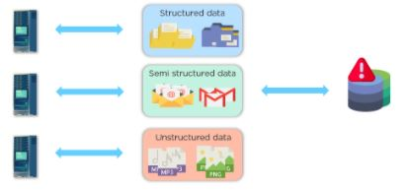
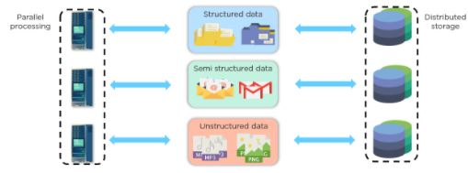
Traditional Management
Distributed Management

Slide 22
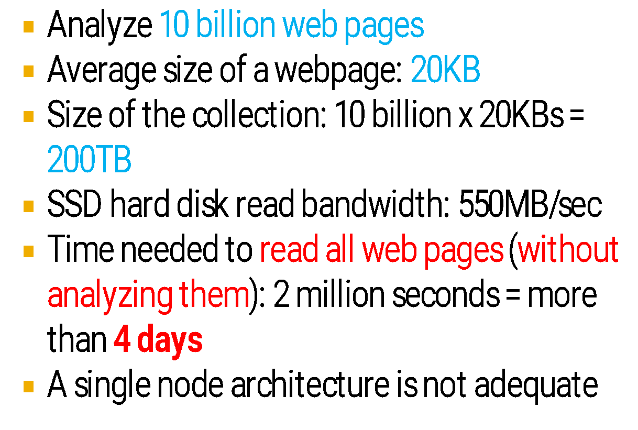
How It All Started – Google File System
Mike Cafarella
& Doug Cutting, were in the process of building a search engine system that can index 1 billion pages.

Slide 23
FILE SYSTEM FOR GOOGLE
A new distributed file system developed to meet the demands of Google’s application workloads and technological environment
Shares many of the same goals as the other distributed file systems
Notes:
The Google file system (GFS) is a file system developed to serve the needs of applications at Google and work efficiently in its technological environment. It is distributed in nature and is highly scalable. Even though the design of the file system is different from the existing file systems, it shares many of the same goals as the other distributed file systems. Lets us look at the nature of application workloads and technological environment at Google that necessitated the design of a new file system.

Slide 24
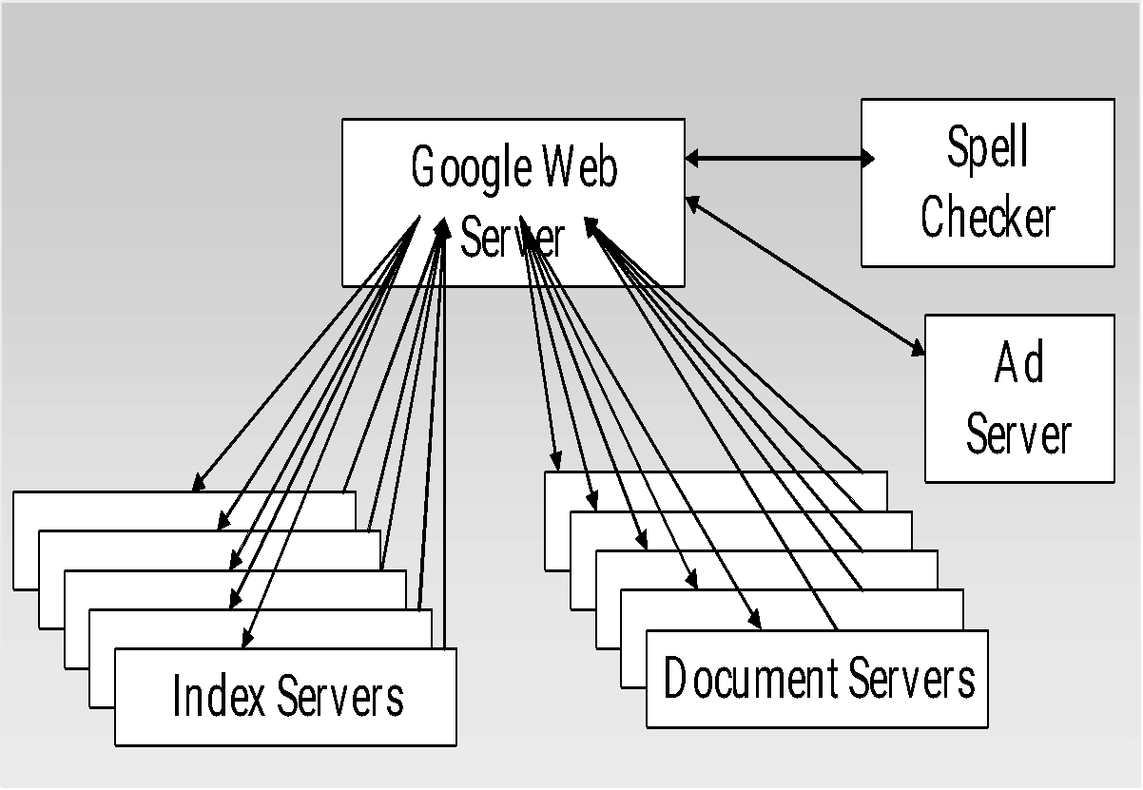
TECHNOLOGICAL ENVIRONMENT
Clusters of more than 15,000 commodity class PCs
Hardware prone to failure
Fault tolerant software
Source: "Web Search for a Planet: The Google Cluster Architecture"
Notes:
Google’s technological environment consists of large clusters. These clusters are made up of cheap commodity class PCs rather than highly expensive, powerful servers. The PCs are prone to failure and hence it is with the help of software that fault tolerance has to be achieved.
The query issued to Google is sent to the ‘Google Web Server’ shown in the diagram, which is a set of servers, one amongst which is chosen to process the query. Each of the ‘Index Servers’ shown in the figure is a cluster of machines and is responsible for storing a part of the inverted index built by the Google Crawler. They compare the terms in the query with the inverted index entries and returns the docids of the matching documents. The results from the various ‘Index Servers’ are merged to produce the final ranking of the docids. These are then sent to the ‘Document Servers’ which is a set of clusters containing the documents. These return the URL and the contents of the matching documents. The snippet matching the query is then formed. In the meantime that adserver and the spell checker do their job.
So the new file system has to work in an environment where failures occur often and where large amounts of data had to be stored and accessed.

Slide 25
APPLICATION WORKLOADS
Sequential reads
Indexer reading the contents of web pages
Frequent Appends
Crawler appending new pages
Files used as Producer – Consumer queues
Indexer waits for the crawler to retrieve contents
Files used for multi-way merging

Slide 26
GFS – MOTIVATION
Component failures – norm rather than exception
Efficient management of large files
Optimization of frequently performed operations
Flexibility of co-designing application and file system
Notes:
Having looked at the technological environment and the nature of the application workloads, let us look at what motivated Google to develop a new file system, rather than using an existing file system.
The clusters used at Google are made out of commodity PCs and failures are expected. So the file system shouldn’t treat machine failures as an exceptional case and should be quick at recovering from machine failures without any performance degradation.
The sizes of the files handled by applications at Google are much larger then the usual files. Also the number of files is numerous. So the file system should be capable of efficient file management.
The file system should provide optimal support for commonly performed operations at Google. The most commonly performed operation on the files is the append operation. The data that Google usually works with, namely contents of web pages, changes frequently. Hence Google found it wise to store the difference (diff) between the current version of the file and the new version at the end of the file, rather than writing the changes into the file. So support for the operation was need with least overhead.
Also the co-designing of the application and the file system API offers flexibility. Google wanted to capitalize on this fact by designing a new file system rather than using an existing one.

Slide 27
GFS - GOALS
Reliability, availability, scalability…
Tolerance to hardware failures
Managing numerous files of large size
Optimizing commonly performed operations
Notes:
The motivations that we just discussed about, led to these goals for the new file system. It had the goals of achieving reliability, availability and scalability like the other DFS. It had to be tolerant to hardware failures which were very common. It had to detect the failures and recover from them quickly. Also it had to manage many large sized files. The sizes of the files were much larger than those supported by traditional DFSs. Also the file system had to be optimized for data appends, because this operation was much more frequent than random writes.

Slide 28
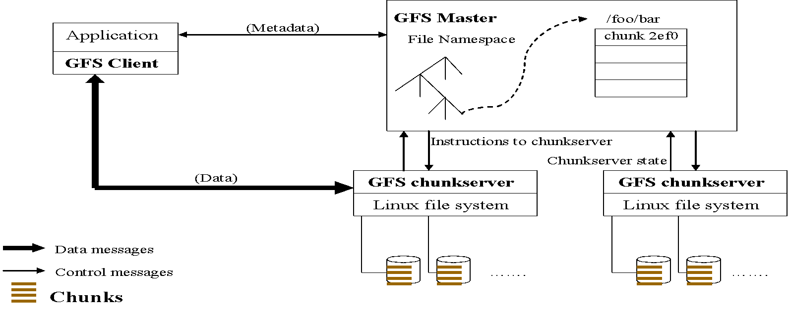
GFS ARCHITECTURE
Single master Multiple chunkservers Multiple clients | Master stores metadata Chunkservers store data Communication via heartbeat messages
Notes:
GFS consists of a single master and multiple chunkservers connected to it. The chunkservers are commodity Linux machines running a user level server process. GFS is accessed by multiple clients. Master stores just the metadata and not the data. It is the chunkserver that stores the data. Communication between master and the chunkservers takes place via periodic heartbeat messages.

Slide 29
GFS ARCHITECTURE (CONTD)
Files are broken into fixed sized chunks
Chunks are identified by unique chunk handles
Chunks are stored in chunkservers
Fixed chunk size – 64 MB
Notes:
The files stored in the GFS are broken down into chunks of a specific size. The size is 64 MB. These chunks have a 64 bit unique identifier. These chunks are stored in the chunkservers as Linux files. Thus the contents of the files are distributed across the chunkservers and the master just stores data about where data is stored (Metadata). Master accessed by the client only to find out which chunkserver contains the data it is interested in. It caches the information returned by the master and for subsequent accesses it doesn’t contact the master. The clients only cache the metadata and not the file data that is read from the chunkservers. This is because their working sets are large and it is mostly streaming data that they work with. The master communicates with all the chunkservers by the exchange of heartbeat messages, which serves several purposes as we shall see.
The chunk size is 64 MB. The advantages of a large size are
i) Reduced client master interaction
ii) Persistent TCP connection
iii) Lesser metadata to be stored in the master

Slide 30
HADOOP
Projects Nutch and Lucene were started with “search” as the application in mind;
Hadoop Distributed file system and MapReduce were found to have applications beyond search.
HDFS and MapReduce were moved out of Nutch as a sub-project of Lucene and later promoted into a apache project Hadoop

Slide 31
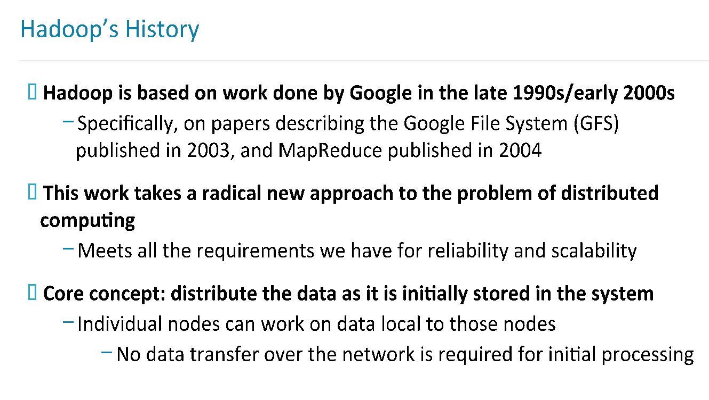

Slide 32
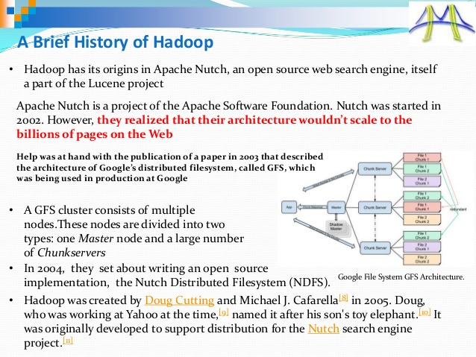

Slide 33
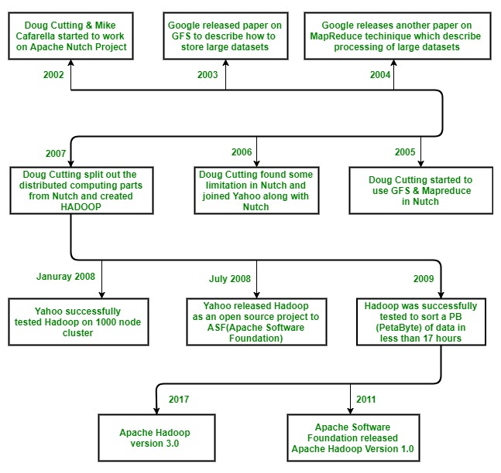

Slide 34
HADOOP INTRODUCTION
Open Source Apache Project
http://hadoop.apache.org/
Written in Java
Does work with other languages
Runs on
Linux, Windows and more
Commodity hardware with high failure rate

Slide 35
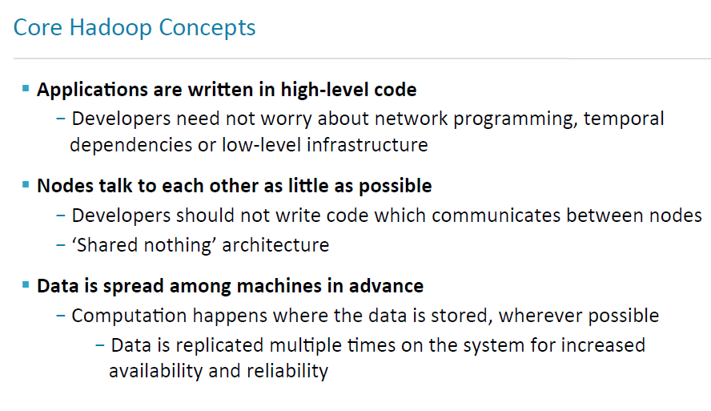

Slide 36
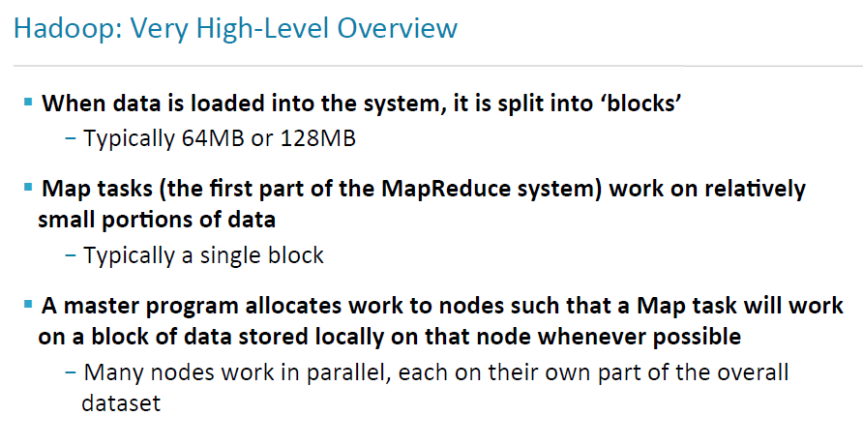

Slide 37
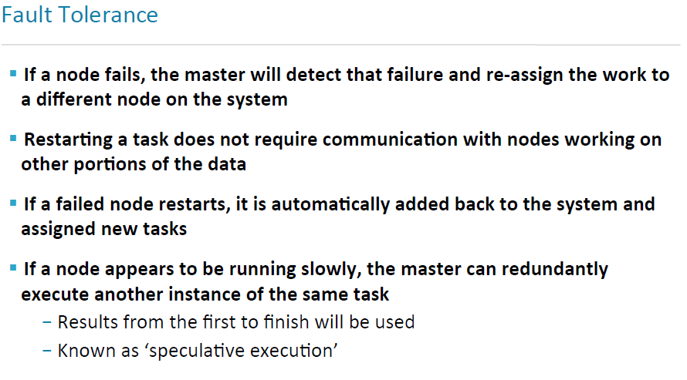

Slide 38
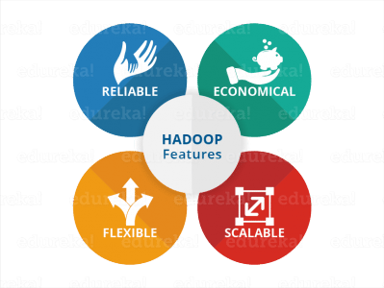
HADOOP
Hadoop is a Platform which enables you to store and analyze large volumes of data.
batch oriented (high throughput and low latency) and strongly consistent (data is always available).
Hadoop is best utilized for:
Large scale batch analytics
Unstructured or semi-structured data
Flat files
Hadoop is comprised of two(3) core components
HDFS (File System)
Map Reduce (YARN)
‹#›

Slide 39
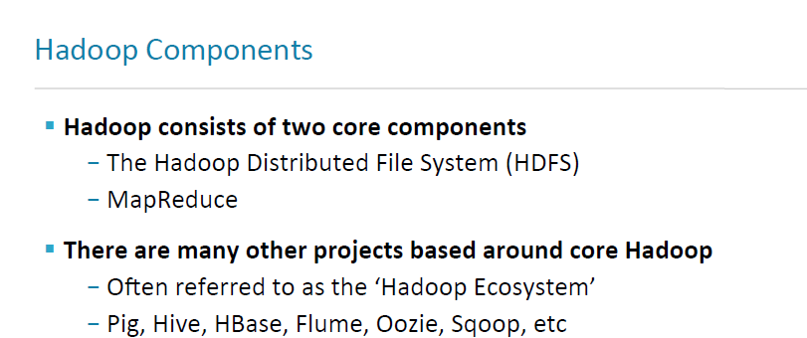
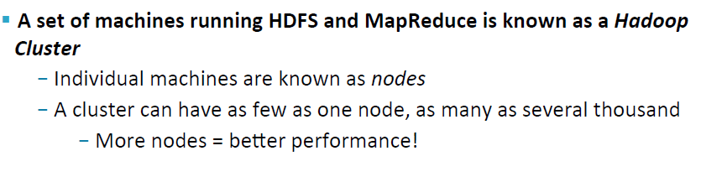

Slide 40

HADOOP’S ARCHITECTURE
Hadoop Distributed Filesystem
Tailored to needs of MapReduce
Targeted towards many reads of filestreams
Writes are more costly
High degree of data replication (3x by default)
No need for RAID on normal nodes
Large blocksize (64MB – 128 MB)
Location awareness of DataNodes in network

Slide 41
WHY HDFS?
Highly fault-tolerant ; High throughput
Can be built out of commodity hardware
Streaming access to file system data
Follows Write-Once-Read-Many-Times pattern. best for batch processing, relaxes the concurrency control needs.
Can store data of any size from any source in any formats, structured or unstructured.
Data locality : moving of computation to data is much easier and faster than moving data . Thus this reduces network congestion and overall turnaround time.
Provides Java API & also a streaming API for other languages.
HTTP browser can be used to browse the files of a HDFS instance.

Slide 42
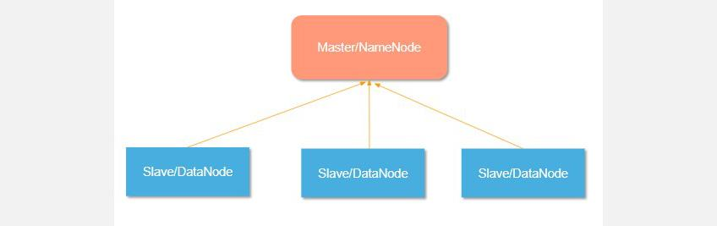
HADOOP HDFS
Hadoop DFS follows master-slave architecture.
The HDFS consists of two types of nodes that are master node and slave nodes.
The master node manages the file system namespace, that is, it stores the metadata about the blocks of files.
The slave nodes store the user data and are responsible for processing data based on the instruction from the master node.

Slide 43
HDFS – ARCHITECTURE
HDFS NameNode
NameNode is the master node. It manages filesystem namespace operations like opening/closing, renaming files, and directories. NameNode maps data blocks to DataNodes and records each change made to the filesystem namespace.
HDFS DataNode
DataNodes are the slave nodes that handle read/write requests from HDFS clients. D

Slide 44
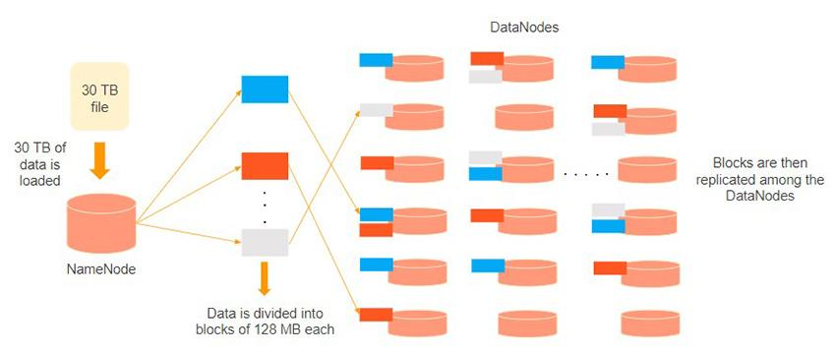
The name node is responsible for the workings of the data nodes. It also stores the metadata.
The data nodes read, write, process, and replicate the data. They also send signals, known as heartbeats, to the name node. These heartbeats show the status of the data node.

Slide 45
HDFS DATA BLOCK
HDFS split large files into small chunks known as Blocks.
Block is the physical representation of data. It contains a minimum amount of data that can be read or write.
HDFS stores each file as blocks.
HDFS client doesn’t have any control on the block like block location, Namenode decides all such things.
By default, HDFS block size is 128MB(64 MB) which you can change as per your requirement. All HDFS blocks are the same size except the last block, which can be either the same size or smaller.
Hadoop framework break files into 128 MB blocks and then stores into the Hadoop file system. Apache Hadoop application is responsible for distributing the data block across multiple nodes.

Slide 46

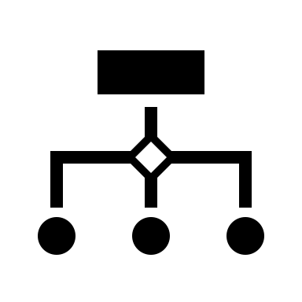
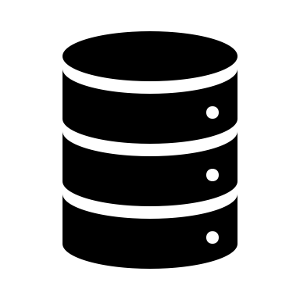



HDFS - NAMENODE
Metadata maintained by the name node includes the name of the file (including path), size, owner, group, permissions, block size etc.
The namenode also gets a report from data nodes called block report that contains the location of each block of a file within that data node.
The namenode stores the metadata about the files in memory as well as disc. This metadata is stored in a file called fsimage.
The block report data is not stored on the disk and is computed dynamically from the block report received from the data nodes.
The fsimage is read from the disk when namenode starts and maintained in memory.

Slide 47
HDFS - NAMENODE
Any changes done to the filesystem (adding a file, removing a file etc) are not written to fsimage immediately and are maintained in a separate file on disk called editlog.
When a name node starts, it syncs the edit log changes with the old fsimage file and updates that into a new copy.
This process of updating the changes from the edit log to the fsimage file can also be done by a periodic checkpointing process by the secondary namenode.

Slide 48

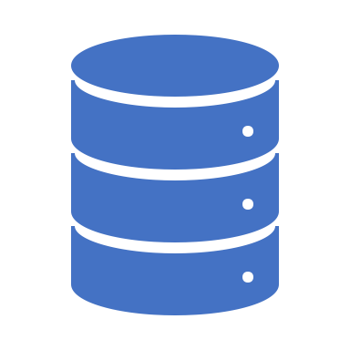
HADOOP - HDFS
Secondary NameNode
DataNode
Fetches FS Image & Edit Log and merges them together into a single file preventing the Edit Log from becoming too large.
Runs on a separate machine than the Primary NameNode
Maintains an out of date image of the merged Name Node image, which could be utilized if the Primary Name Node fails.
to retrieve blocks of data when it is told to do so by either the Clients and/or NameNode.
Stores all the raw blocks that represent the files being stored.
Periodically reports back to the NameNode with lists of blocks it is storing.
‹#›

Slide 49
HDFS DATANODE
DataNodes are the slave nodes in Hadoop HDFS.
DataNodes are inexpensive commodity hardware.
They store blocks of a file.
DataNode is responsible for serving the client read/write requests.
Based on the instruction from the NameNode, DataNodes performs block creation, replication, and deletion.
DataNodes send a heartbeat to NameNode to report the health of HDFS.
DataNodes also sends block reports to NameNode to report the list of blocks it contains.

Slide 50
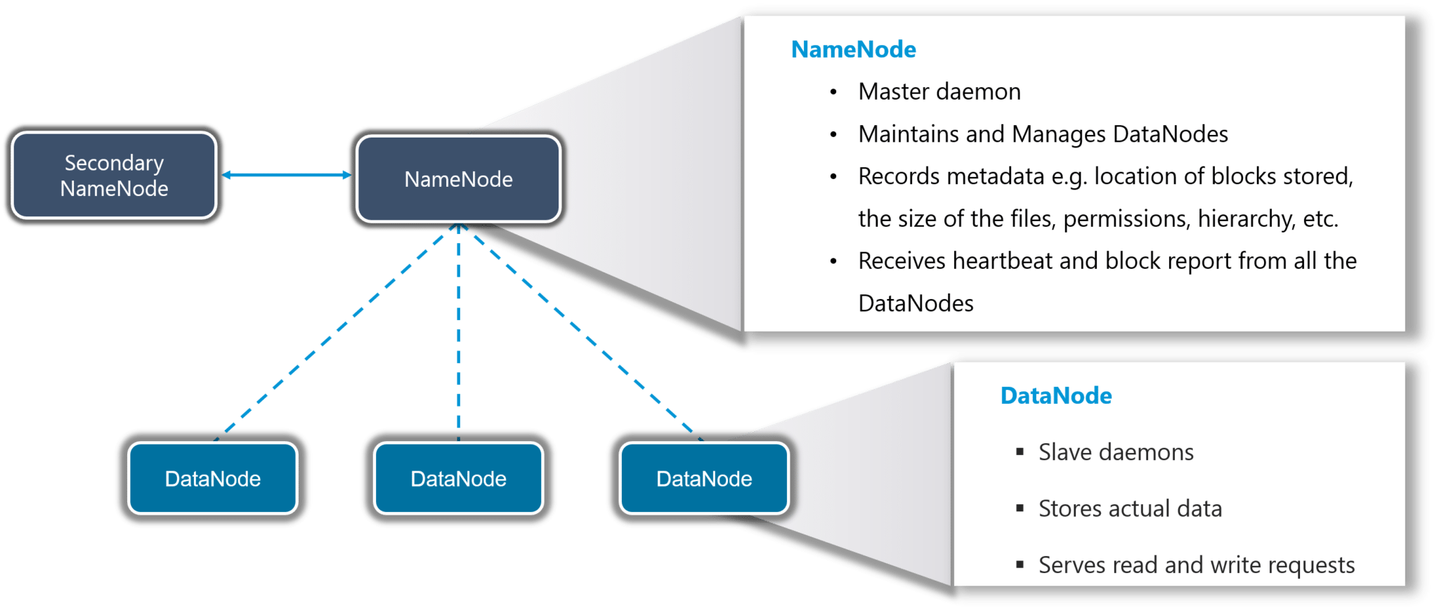

Slide 51

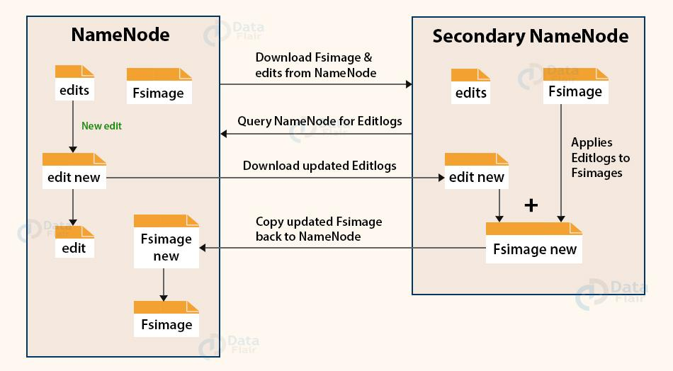
Secondary Namenode

Slide 52
Secondary Namenode
helper node to primary NameNode doesn’t replace primary NameNode.
When the NameNode starts, the NameNode merges the Fsimage and edit logs file to restore the current file system namespace.
Since the NameNode runs continuously for a long time without any restart, the size of edit logs becomes too large. This will result in a long restart time for NameNode.
Secondary NameNode downloads the Fsimage file and edit logs file from NameNode.
It periodically applies edit logs to Fsimage and refreshes the edit logs. The updated Fsimage is then sent to the NameNode so that NameNode doesn’t have to re-apply the edit log records during its restart. This keeps the edit log size small and reduces the NameNode restart time.
If the NameNode fails, the last save Fsimage on the secondary NameNode can be used to recover file system metadata.

Slide 53
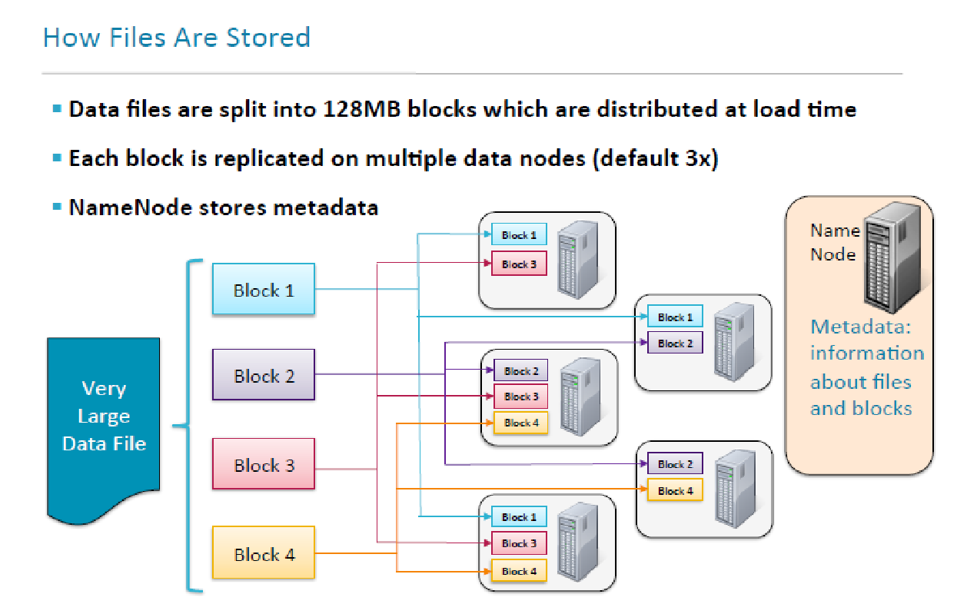

Slide 54
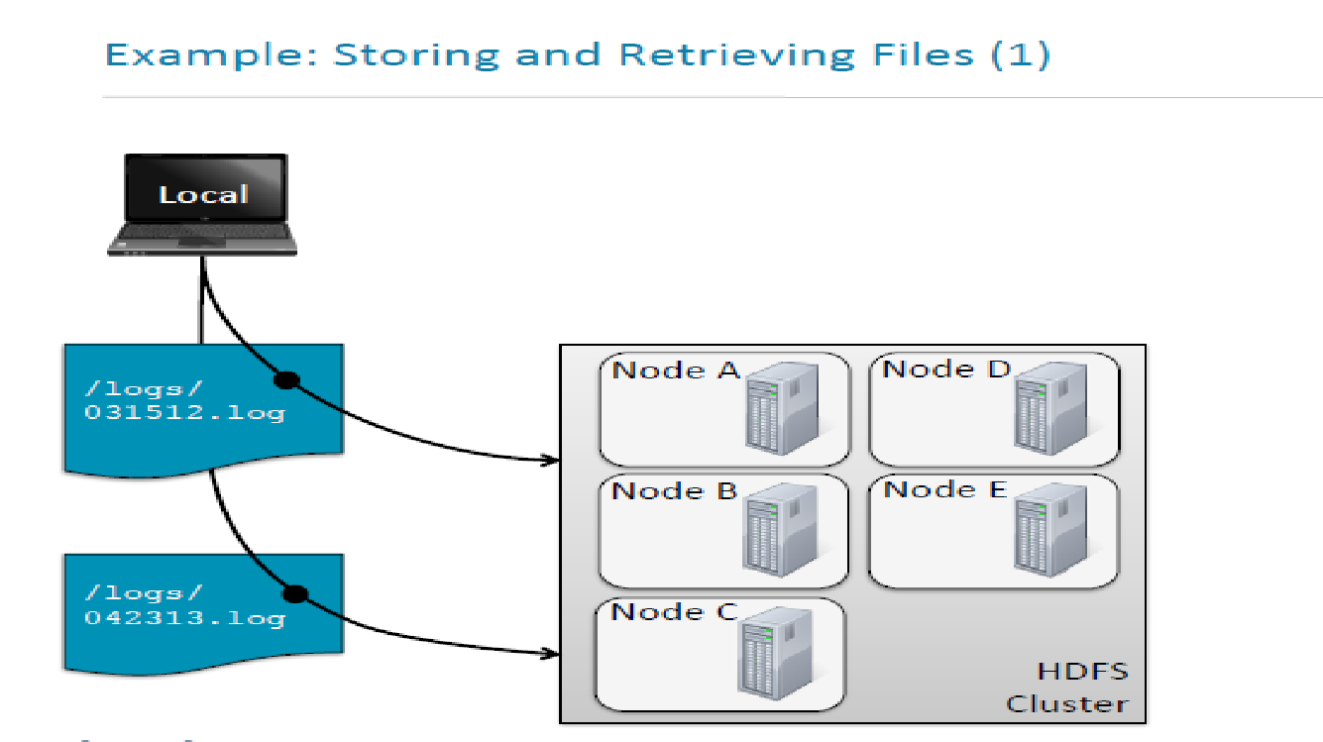

Slide 55
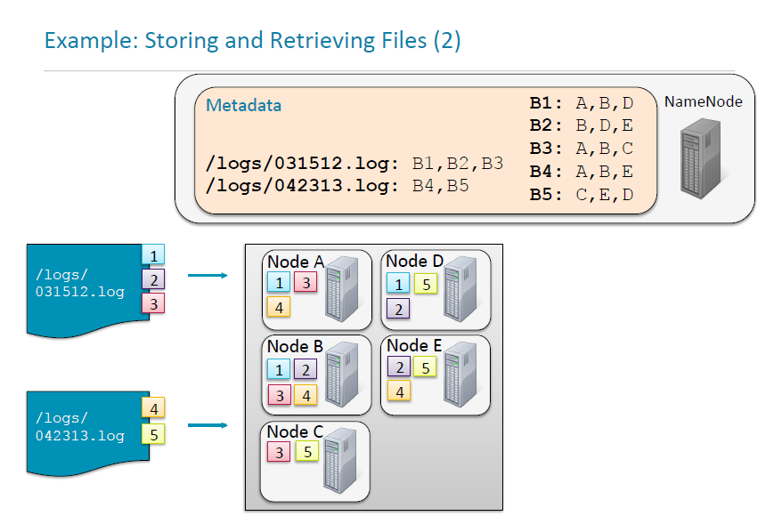

Slide 56
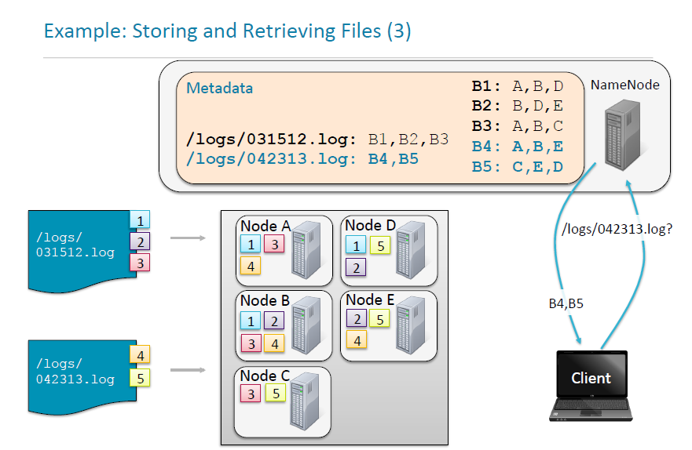

Slide 57
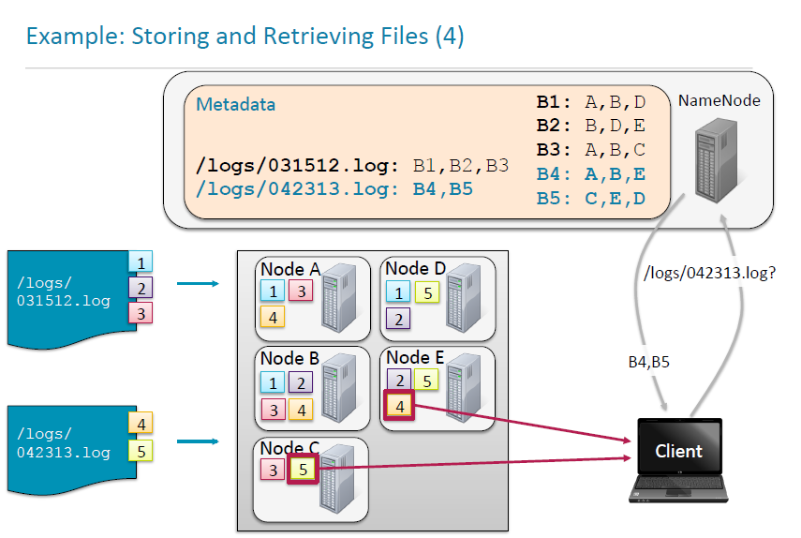

Slide 58
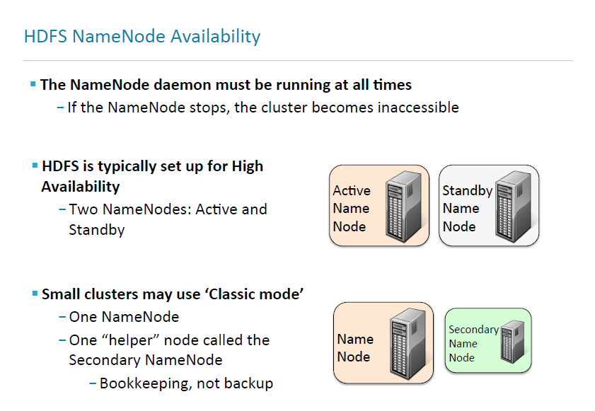

Slide 59
HADOOP HDFS
NameNode – Determining Replica Placement
How does the NameNode choose which DataNodes to store replica blocks on?
File Reads (Process)
Data Nodes are sorted by proximity to the Client
Clients contact DataNodes directly to retrieve data and the NameNode simply guides the Client to the best datanode for each block of data being read.
If an error occurs while reading a block from a DataNode, then the NameNode will try the next closest DataNode to the Client in order to retrieve the block of data.
DataNodes that fail are reported back to the NameNode.
‹#›

Slide 60
RACK AWARENESS
Rack Awareness in Hadoop is the concept that chooses closer Datanodes based on the rack information.
By default, Hadoop installation assumes that all the nodes belong to the same rack.
To improve network traffic while reading/writing HDFS files in large clusters of Hadoop.
NameNode chooses data nodes, which are on the same rack or a nearby rock to read/ write requests (client node).
HDFS Namenode achieves this rack information by maintaining rack ids of each data node.

Slide 61
Replica Placement Via Rack Awareness
A simple policy is to place replicas on the rack to prevent losing of data when an entire rack fails. And allow the use of bandwidth from multiple racks when reading a file.
On multiple rack clusters, block replication follows the below policy:
You should not place more than one replica on one node.
You should also not place more than two replicas on the same rack.
This has a bottleneck that number of racks used for block replication should be always less than the total number of block replicas.

Slide 62
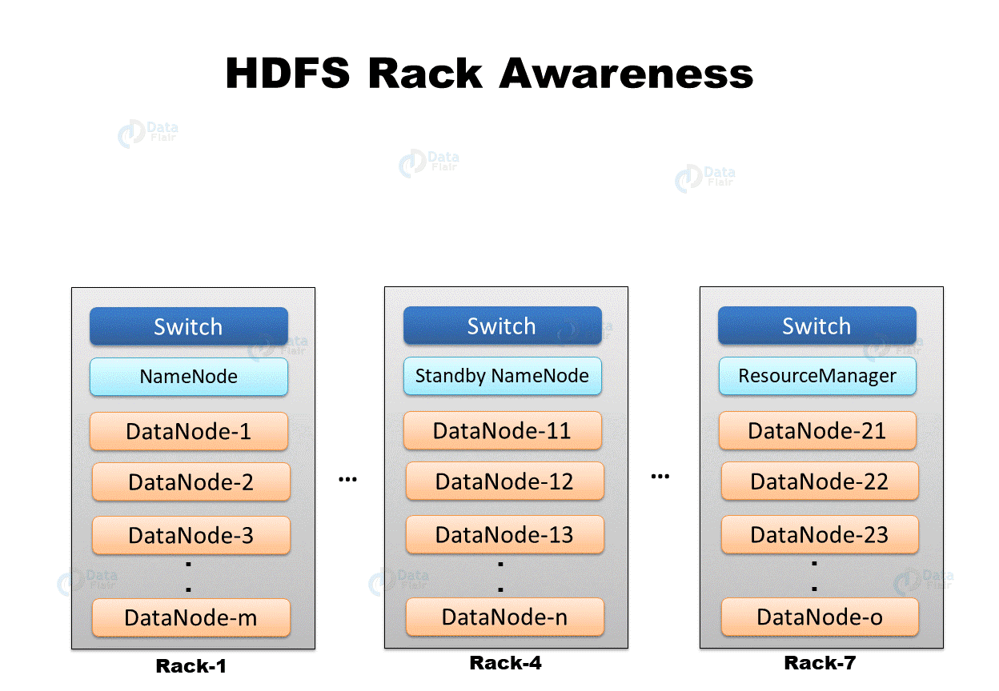

Slide 63
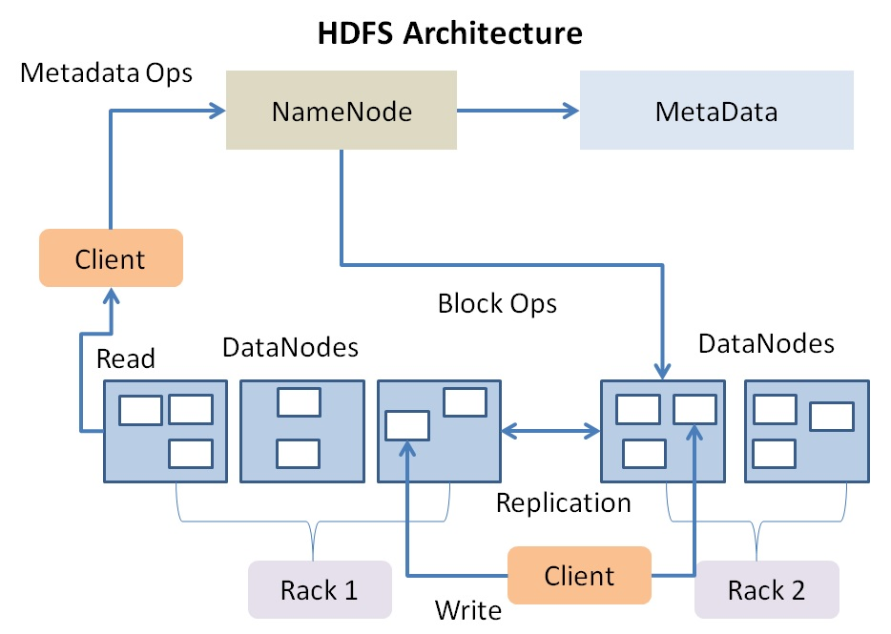

Slide 64
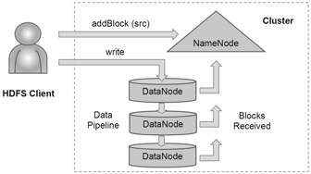
HADOOP HDFS
File Writes (Creating a New File)
‹#›
Notes:
Image pulled from Internet….

Slide 65
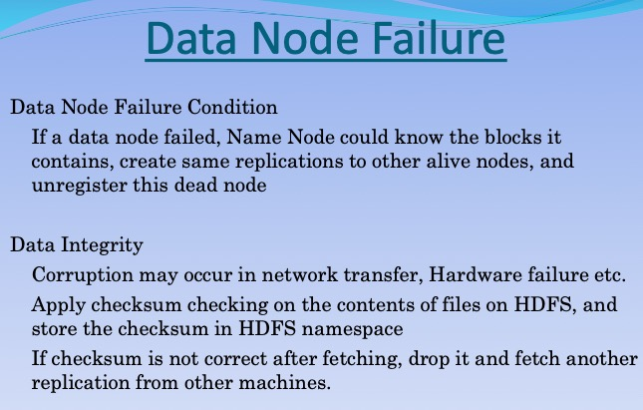

Slide 66
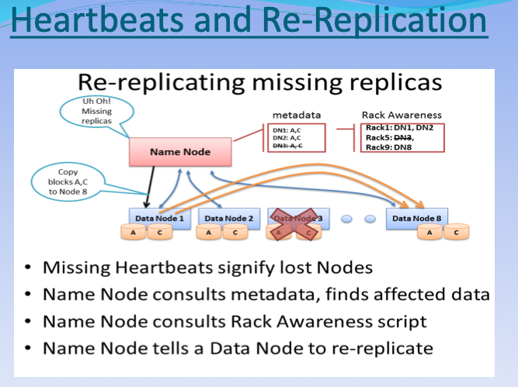

Slide 67
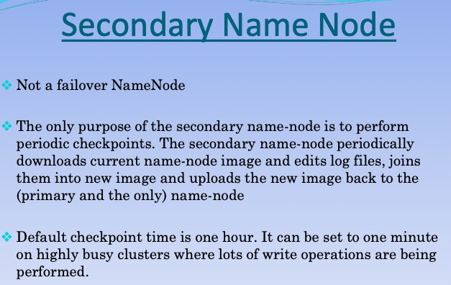

Slide 68
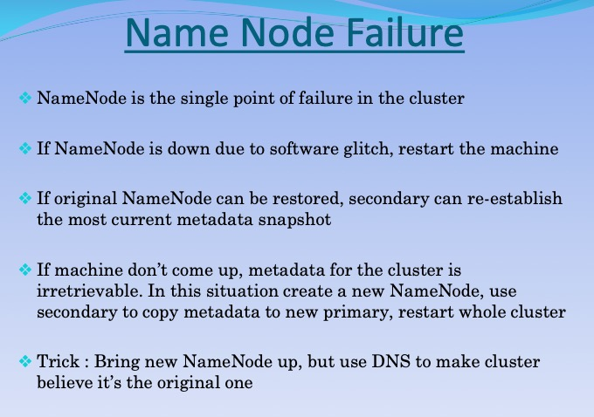

Slide 69
HDFS SUMMARY
HDFS Master
NameNode
Runs on a single node as a master process
Directs client access to files in HDFS
HDFS Slave
DataNode
Runs on all nodes in the cluster
Block creation/replication/deletion
Takes orders from the namenode
Hadoop Distributed File System
Stores files in blocks across many nodes in a cluster
Replicates the blocks across nodes for durability
Default – 128 MB
Master/Slave Architecture

Slide 70
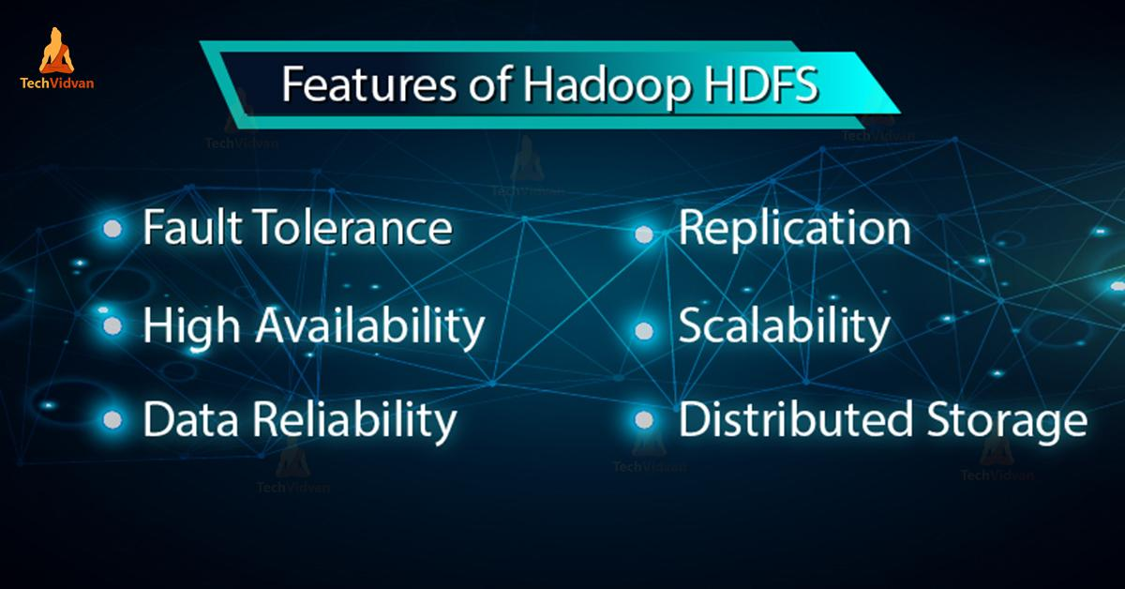

Slide 71
HDFS Namenode High Availability Architecture
NameNode was the Single Point of Failure (SPOF) before Hadoop 2.0. If the NameNode fails, the whole cluster goes down.
Introduction of Hadoop 2.0 overcome this SPOF by providing support to multiple NameNode.
Provides the option of running two redundant NameNodes in the same cluster in an active/passive configuration with a hot standby.
Active NameNode – It handles all HDFS client operations in the HDFS cluster.
Passive NameNode – It is a standby namenode. It has similar data as active NameNode.
So, whenever Active NameNode fails, passive NameNode will take all the responsibility of active node.

Slide 72
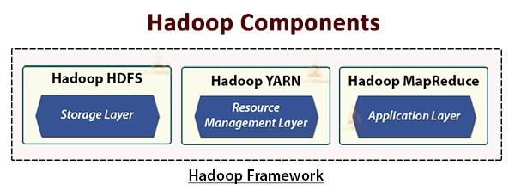
HADOOP - MAPREDUCE
Software framework for writing applications which process very large datasets (multi-terabyte data sets) in parallel on large clusters of machines. Essentially enabling the user to run analytics across large blocks of data.
The MapReduce Framework takes care of scheduling tasks, monitoring them, and re-executing failed tasks.
‹#›

Slide 73
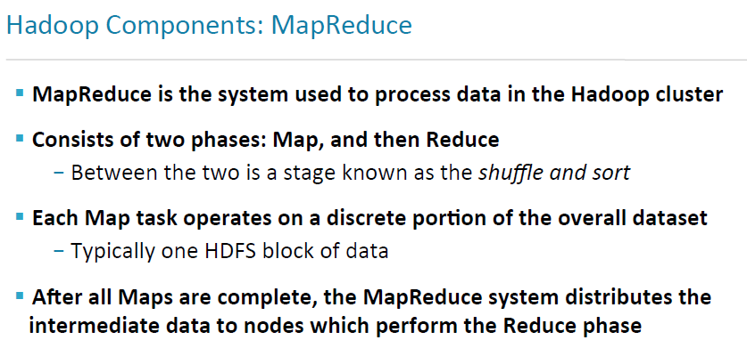

Slide 74
MAP REDUCE - MR
MR processes the data in parallel across multiple machines in the cluster.
It works by dividing the task into independent subtasks and executes them in parallel across various DataNodes.
MR processes the data into two-phase, that is, the Map phase and the Reduce phase.
The input and output of both the phases are the key, value pairs.
The programmer specifies the two functions, that is, map function and the reduce function.
In map function, the programmer writes the business logic for processing the data.
In the Reduce function, the programmer writes the logic for summarizing and aggregating the intermediate output of the map function and generates the output.

Slide 75
MAPREDUCE
similar to divide-and-conquer
First, use “Map” to divide tasks
Second, use “Shuffle” to “transfer the data from the mapper nodes to a reducer’s node and decompress if needed. “
Third, use “Reduce” to “execute the user-defined reduce function to produce the final output data. “

Slide 76
MAPREDUCE - Process
Hadoop divides the job into tasks of two types, that is, map tasks and reduce tasks. These tasks run on different DataNodes.
The input to the MR job is divided into fixed-size pieces called input splits.
One map task which runs a user-defined map function for each record in the input split is created for each input split.
These map tasks run on the DataNodes where the input data resides.
Output of the map task is intermediate output & written to the local disk.
The intermediate outputs of the map tasks are shuffled and sorted and are then passed to the reducer.
For a single reduce task, the sorted intermediate output of mapper is passed to the node where the reducer task is running. These outputs are then merged and then passed to the user-defined reduce function.
The reduce function summarizes the output of the mapper and generates the output. The output of the reducer is stored on HDFS.

Slide 77
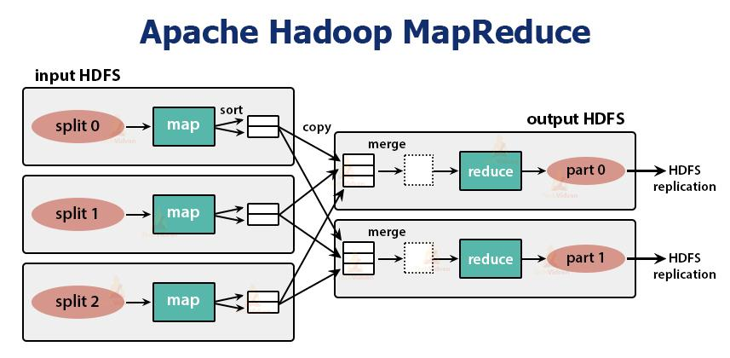

Slide 78
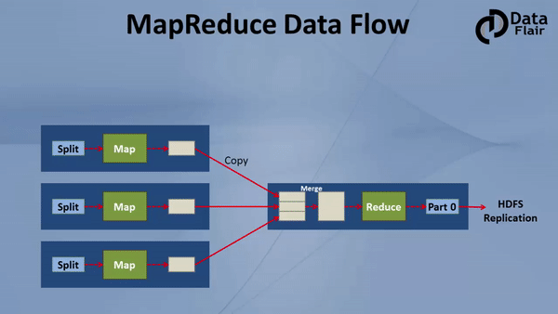
MapReduce Flow

Slide 79
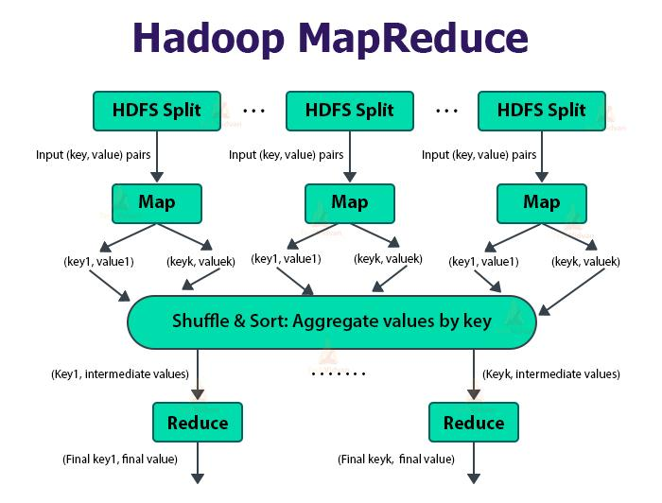

Slide 80
HADOOP / MAPREDUCE
One master JobTracker & one slave Task Tracker per cluster node.
Job Tracker
Coordinates all jobs run on the system, scheduling tasks to run on Task Trackers. If a Job fails then it can re-schedule to another Task Tracker.
Stores in-memory information about every running MapReduce Job
Assigns Tasks to m/cs in the cluster; to m/cs with Data Locality.
Task Tracker
Runs Tasks and sends progress reports to the Job Tracker
Has a local directory to create a localized cache
Code is essentially moved to the data (Map Reduce Jars). It is more efficient to move around small jar files then moving around data. Map Reduce Jars are sent to Task Trackers to run locally
‹#›

Slide 81

HADOOP CLUSTER ARCHITECTURE:

Slide 82
MapReduce - Architecture
A job is divided into multiple tasks which are then run onto multiple data nodes in a cluster.
It is the responsibility of job tracker to coordinate the activity by scheduling tasks to run on different data nodes.
Execution of individual task is then to look after by task tracker, which resides on every data node executing part of the job.
Task tracker's responsibility is to send the progress report to the job tracker.
In addition, task tracker periodically sends 'heartbeat' signal to the Jobtracker so as to notify him of the current state of the system.
Thus job tracker keeps track of the overall progress of each job. In the event of task failure, the job tracker can reschedule it on a different task tracker.

Slide 83


Slide 84

HADOOP ARCHITECTURE

Slide 85


Slide 86
CURRENT MAPREDUCE LIMITATIONS
Scalability
Maximum Cluster Size – 4000 Nodes
Maximum Concurrent Tasks – 40000
Coarse synchronization in Job Tracker
Single point of failure
Failure kills all queued and running jobs
Jobs need to be resubmitted by users
Restart is very tricky due to complex state

Slide 87

HADOOP 2

Slide 88


Slide 89


Slide 90



HADOOP YARN
Hadoop YARN stands for Yet Another Resource Negotiator. It is the resource management unit of Hadoop and is available as a component of Hadoop version 2.
Hadoop YARN acts like an OS to Hadoop. It is a file system that is built on top of HDFS.
It is responsible for managing cluster resources to make sure you don't overload one machine.
It performs job scheduling to make sure that the jobs are scheduled in the right place

Slide 91


Slide 92
YARN- OVERVIEW
YARN is designed with the idea of splitting up the functionalities of job scheduling and resource management into separate daemons.
The basic idea is to have a global ResourceManager and application Master per application where the application can be a single job or DAG of jobs.
YARN consists of
ResourceManager
NodeManager,
per-application ApplicationMaster.

Slide 93


Slide 94

HADOOP YARN

Slide 95
ResourceManager
arbitrates resources amongst all the applications in the cluster.
It has two main components.
b. ApplicationManager
responsible for accepting the job submissions.
negotiates the first container for executing application-specific ApplicationMaster.
They provide service for restarting the ApplicationMaster container on failure.
The per-application ApplicationMaster is responsible for negotiating containers from the Scheduler.
It tracks and monitors their status and progress.
a. Scheduler
allocates resources to the various applications running in the cluster, considering the capacities, queues, etc.
pure Scheduler. It does not monitor or track the status of the application.
does not guarantee the restart of the failed tasks that are failed either due to application failure or hardware failure.
It performs scheduling based on the resource requirements of the applications.

Slide 96
Other Components
NodeManager:
NodeManager runs on the slave nodes. It is responsible for containers, monitoring the machine resource usage that is CPU, memory, disk, network usage, and reporting the same to the ResourceManager or Scheduler.
ApplicationMaster:
The per-application ApplicationMaster is a framework-specific library. It is responsible for negotiating resources from the ResourceManager. It works with the NodeManager(s) for executing and monitoring the tasks.

Slide 97


Slide 98

ARCHITECTURE OF HADOOP

Slide 99
HADOOP ECOSYSTEM
The Hadoop ecosystem is diverse and grows by the day.
It is impossible to keep track of all of the various projects that interact with Hadoop in some form
The goal for many of these Hadoop-related projects is to increase the accessibility of Hadoop to programmers and nonprogrammers.

Slide 100


Slide 101


Slide 102


Slide 103


Slide 104



Slide 105

COMPARISON

Slide 106
WHY HADOOP? - TECHNICAL
Simple structure vs. Optimization
Transaction time not minimized
Lower performance with same number of nodes
No compelling reason to choose Hadoop

Slide 107
WHY HADOOP- COMMERCIALLY
Cheap (Buy more servers to beat DBMS)
Flexible (Both in design and deployment)
Easier to design
Easier to scale up
Combine with other system to achieve better performance

Slide 108


Slide 109
HBASE
HBase is a distributed Key / Value store built on top of Hadoop and is tightly integrated with the Hadoop MapReduce framework. HBase is an open source, distributed, column oriented database modeled after Google’s BigTable.
HBase shines with large amounts of data, and read/write concurrency.
Automatic Partitioning – as your table grows, they will automatically be split into regions and distributed across all available nodes.
Does not have indexes. Rows are stored sequentially, as are the columns written to each row.
HBase makes Hadoop useable for real time streaming workloads which the Hadoop File System cannot handle itself.
‹#›

Slide 110
OOZIE
Is a workflow scheduler. It manages data processing jobs (e.g. load data, storing data, analyze data, cleaning data, running map reduce jobs, etc.) for Hadoop.
Users create Directed Acyclical Graphs to model their workflow. Oozie at runtime manages the dependencies and execute the actions when the dependencies identified in DAG are satisfied.
Supports all types of Hadoop jobs and is integrated with the Hadoop stack.
Supports data and time triggers, users can specify execution frequency and can wait for data arrival to trigger an action in the workflow.
‹#›

Slide 111
ZOOKEEPER
Zookeeper is a stripped down filesystem that exposes a few simple operations and abstractions that enable you to build distributed queues, configuration service, distributed locks, and leader election among a group of peers.
Configuration Service – store and allows applications to retrieve or update configuration files
Distributed Lock – is a mechanism for providing mutual exclusion between a collection of processes. At any one time, only a single process may hold the lock. They can be utilized for leader election, where the leader is the process the holds the lock at any point of time.
Zookeeper is highly available running across a collection of machines.
‹#›
Notes:
Talk about leader election for backups - Zettaset

Slide 112
HIVE
Utilized by individuals with strong SQL Skills and limited programming ability.
Compatible with existing Business Intelligence tools that utilize SQL and ODBC.
Metastore – central depository of Hive Metadata.
It is comprised of a service and a backup store for the data.
Usually a standalone Database such as MySQL is utilized for the standalone Metastore.
Partial support of SQL-92 specification
‹#›

Slide 113
PIG
Pig and Hive were written to insulate users from the complexities of writing MapReduce Programs. MapReduce requires users to write mappers and reducers, compilation of the code, submitting jobs and retrieving the results of the jobs. This is a very complex and time consuming process.
A Pig program is made up up of a series of operations, or transformations that are applied to the input data to produce a desired output. The operations describe a data flow, which is converted into a series of MapReduce Programs.
PIG is designed for batch processing of data. Pig is not designed to handle a small amount of data, since it has to scan the entire dataset.
PIG is comprised of two components:
The Language (Pig Latin) utilized to express data flows
The Execution Environment to run Pig Latin Programs.
‹#›

Slide 114

SPARK: An open source cluster computing framework.
It provides 100 times faster performance as compared to MapReduce.
For few applications with in-memory primitives as compared to the two-state disk-based MapReduce.
Spark run in the Hadoop cluster & process data in HDFS it also supports a wide variety of workload.

Slide 115
APACHE SPARK
Apache Spark is a data processing framework that can quickly perform processing tasks on very large data sets and can also distribute data processing tasks across multiple computers, either on its own or in tandem with other distributed computing tools.
easy-to-use API that abstracts away much of the grunt work of distributed computing and big data processing.

Slide 116
APACHE SPARK
Started at U.C. Berkeley in 2009, Apache Spark has become one of the key big data distributed processing frameworks in the world.
Spark can be deployed in a variety of ways, provides native bindings for the Java, Scala, Python, and R programming languages, and supports SQL, streaming data, machine learning, and graph processing.
Used by banks, telecommunications companies, games companies, governments, and all of the major tech giants such as Apple, IBM, Meta, and Microsoft.

Slide 117
SPARK RDD
At the heart of Apache Spark is the concept of the Resilient Distributed Dataset (RDD), a programming abstraction that represents an immutable collection of objects that can be split across a computing cluster.
Operations on the RDDs can also be split across the cluster and executed in a parallel batch process, leading to fast and scalable parallel processing.
Apache Spark turns the user’s data processing commands into a Directed Acyclic Graph, or DAG.

Slide 118
SPARK RDD
The DAG is Apache Spark’s scheduling layer; it determines what tasks are executed on what nodes and in what sequence.
RDDs can be created from simple text files, SQL databases, NoSQL stores (such as Cassandra and MongoDB), Amazon S3 buckets, and much more besides.
Much of the Spark Core API is built on this RDD concept, enabling traditional map and reduce functionality, but also providing built-in support for joining data sets, filtering, sampling, and aggregation.
Spark runs in a distributed fashion by combining a driver core process that splits a Spark application into tasks and distributes them among many executor processes that do the work.
These executors can be scaled up and down as required for the application’s needs.

